Slide 1
Bridging the Data Skills Gap:
The Role of the UK’s National Innovation Centre for Data and its Data Innovation Bootcamp
Prof. Barry Hodgson, UKs National Innovation Centre for Data Newcastle University.

Slide 2
Journalists have a well defined model for
content – hijack this for good communication
1. Conclude
Headline
Body of text and supporting details
2. Support
3. Call-to-action
What to do with this information

Slide 3
1. Conclude
Data Innovation Bootcamps are great because they enable students to learn about innovation and data by working with industry and using real world business problems
2. Support
I’ll tell you a few things about our experience
3. Call-to-action
I think we should all be doing more activities like this and I’d like to talk to all of you about similar activities that you may already do and maybe there’s some way we can collaborate?

Slide 4

Research
⇨
10010101
11001010
11100100
10101001
Notes:
Researchers working with data continue to make a significant contribution to research, driving forward a wide range of domains, including science, healthcare and increasingly the humanities. We do this by working closely with researchers from these domains, creating novel applications and in some cases, new underpinning methods.
However, these skills can also be applied to create an impact beyond research – a direct impact on the economy and society.
While this sounds high level, it translates to prosperity, more & better jobs, and better lives for citizens

Slide 5
Research
Impact
⇨
⇨
10010101
11001010
11100100
10101001
£
Notes:
At Newcastle, we have always devoted some of our efforts to this as we want to help create prosperity, better jobs and better lives for citizens.
However, we were being approached by more and more companies & public sector orgs.
They were drowning in data and had ideas about how this could be used to transform their organisations.. … , but lacked the skills to do this.
In contrast, universities and in particular e-science groups, have these skills in abundance, but in order to make a significant impact on the economy and society we realised that we couldn’t just do this as a part-time activity - we needed to significantly scale up our efforts... and so we created the UK National Innovation Centre for Data. I want to tell you something about what we do, and how we believe that this should be a key future direction for eScience.

Slide 6

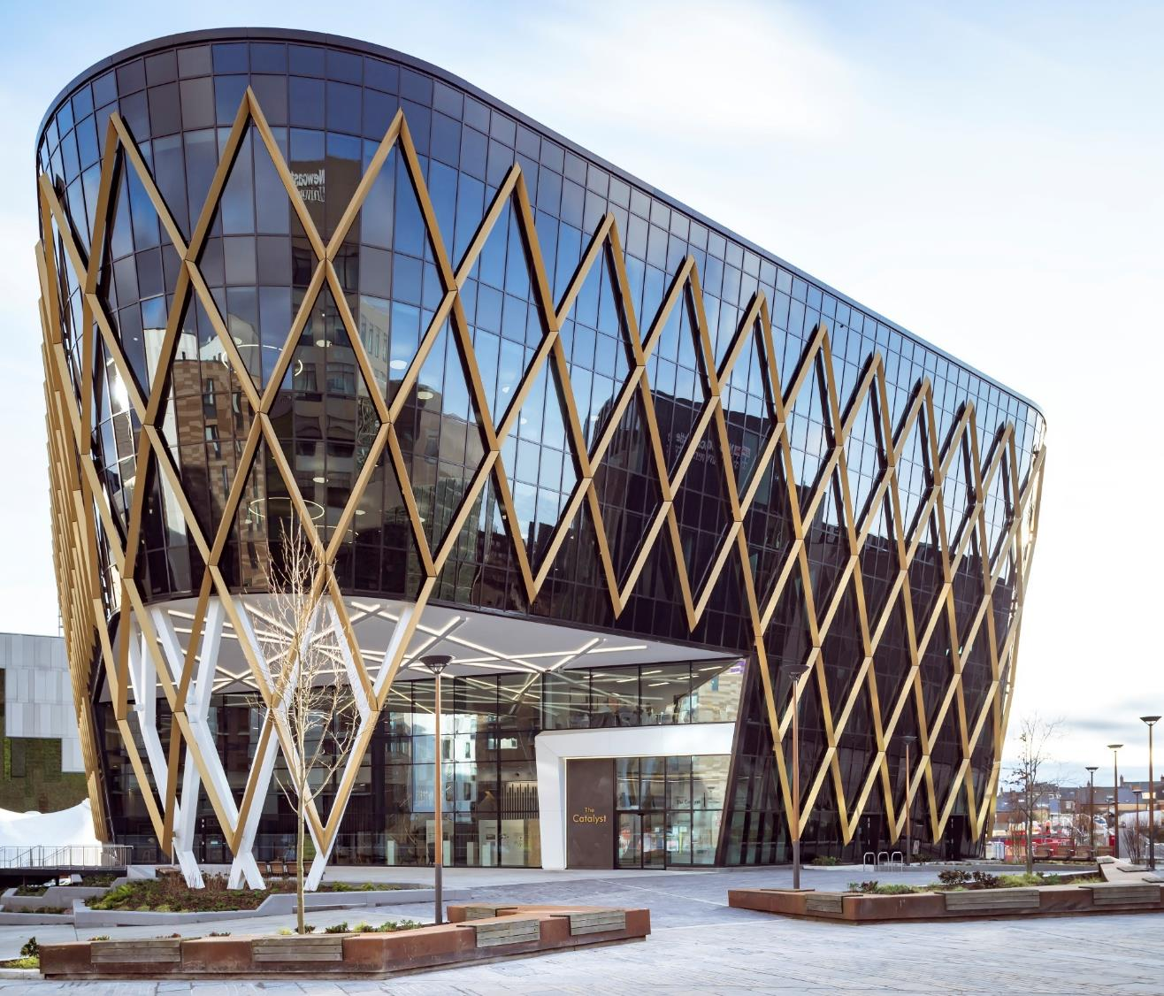
€30M investment
€50M innovation facility
Innovation by harnessing:
  data science experts
  public & private sector
  researchers
  students
Notes:
In 2016 we made a case to government that the economy was being held back by a lack of data skills – companies being unable to extract value from their data.
To achieve more than any one group could on their own.

Slide 7
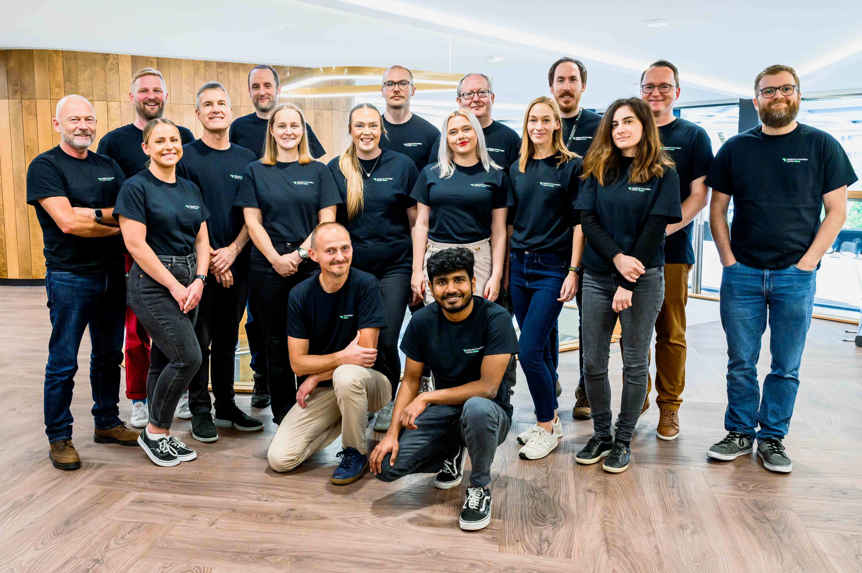
Skills:
Statistics
Data Engineering
Visualisation
Machine Learning
AI
Notes:
Unusually for a university, we are purely focussed on impact on external organisations. No teaching or research for its own sake.
The model we use is run collaborative projects with business.
We focus on their business problem. Work with them to properly scope the business question and then create a programme of data science upskilling that enables them to undertake the tasks they need to create efficiencies or new products and services.
The model seems to work well.

Slide 8



































Collaborators: Private Sector
Notes:
We’ve now run over 100 of these projects with private sector, public sector and 3rd sector organisations.

Slide 9
















Collaborators: Public Sector and 3rd Sector

Slide 10
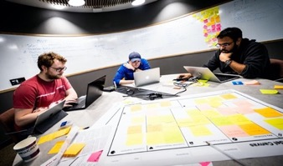
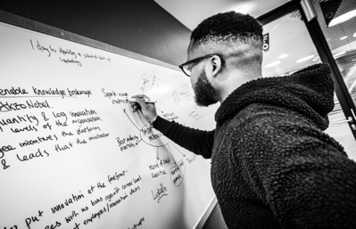
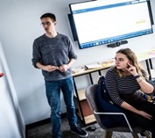

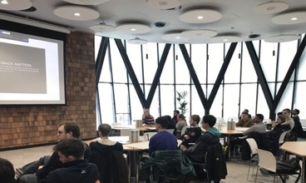
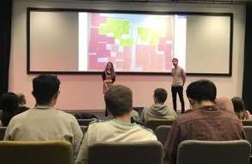
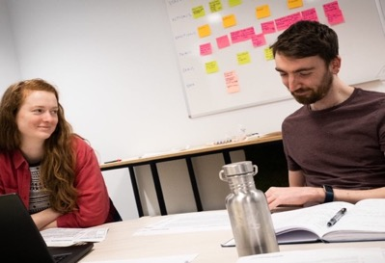

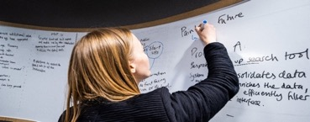
Data Innovation Bootcamps
Notes:
The question then for us was … how can we take the learning from these projects – i.e. how to resolve business issues with a helping hand from data science to gain insight in to the best solution… and feed that back to the students base at Newcastle University?

Slide 11
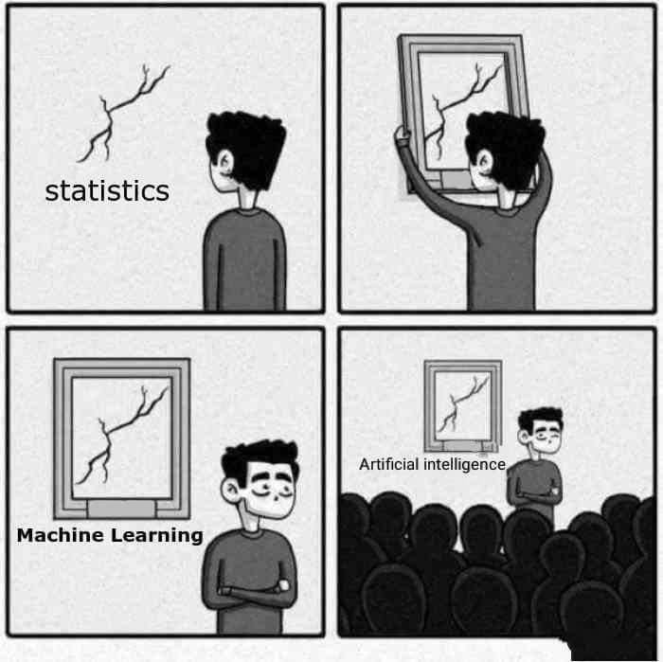
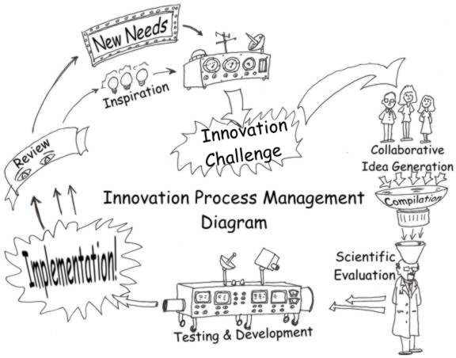
In the beginning…
Notes:
We had lots of failures on the way!
It turns out that in our experience very technical computing scientists/data scientists are great at the tech bit and less interested in the business innovation bit!

Slide 12
In the beginning…
Long and thin modules running over 8-12 weeks
Alongside other ‘technical’ modules
Distraction from innovation module
Focus and attention waned
Failed to build on learning each week
Lost interest as more interesting technical modules to explore!
Became a box ticking exercise…
Notes:
Timetabling multiple modules forced the teaching to be delivered in linear blocks, repeating each week over 8-12 weeks.
We were asking students to work in groups – they didnt like it.
We were asking students to come up with their own business ideas – they didn’t ;ike it
We were asking students to get out the building and talk to other people – potentially their customers – they hated it!

Slide 13

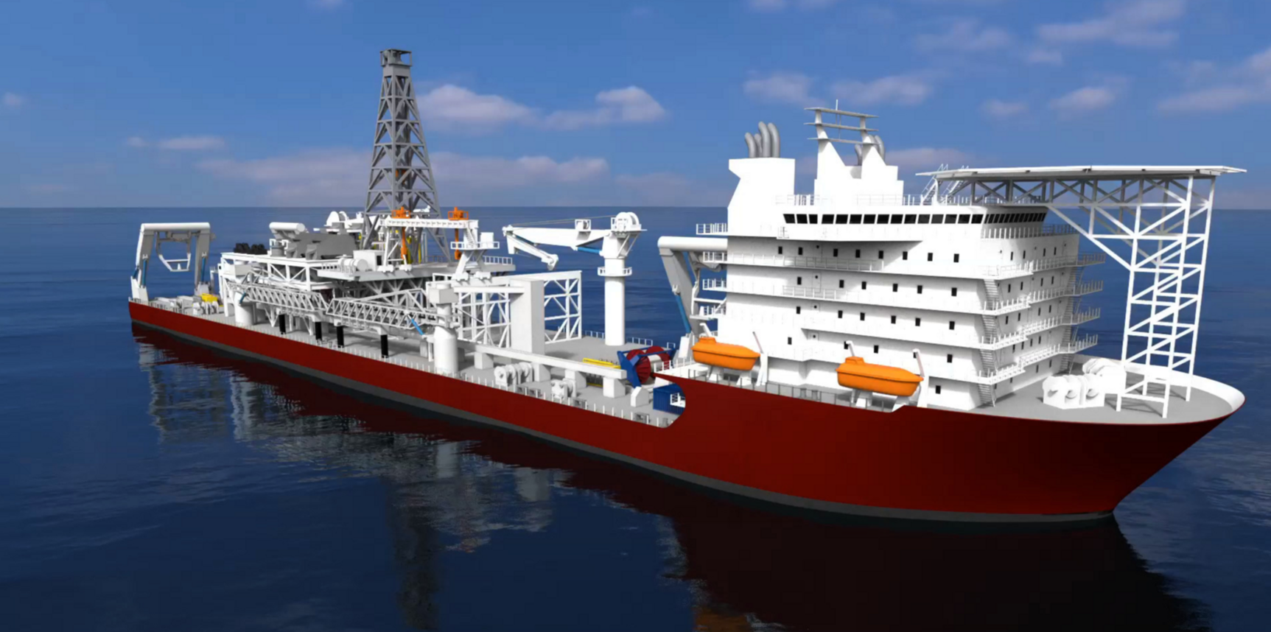
AkzoNobel Global & International®
Data Set
Data (years 2008-2015) 2TB:
  IMO
  Locations of all 7000 vessels around the world every 15 mins
  Speed
  Type
  Length
  Draught
  Ports – destinations
  Painted by IP or not
Notes:
So, on the verge of giving up the module as it wasn’t working. Had an eye watering report about student feedback from the exam board moderator…!!
Then about a week later I was talking to AkzoNobel… they had data

Slide 14
Plotting Vessel Movements
Value in seeing locations visited by a vessel over the timespan of our data
How can we present this data in a clear way?
Can we find vessels that are representative of a certain type?
Notes:
…and they had a business problem. So, we thought maybe we could get the students to focus on this in a solid block at AkzoNobel’s paint plant!

Slide 15
Data Innovation Bootcamp Outline
10 contiguous days
40 students
4 problem owners (from 4 different businesses) – providing 4 domain related data sets to explore
Students in groups of 5 (no prior requirements, different academic disciplines)
Notes:
And we. Built a new model which we called the Data Innovation Bootcamp

Slide 16

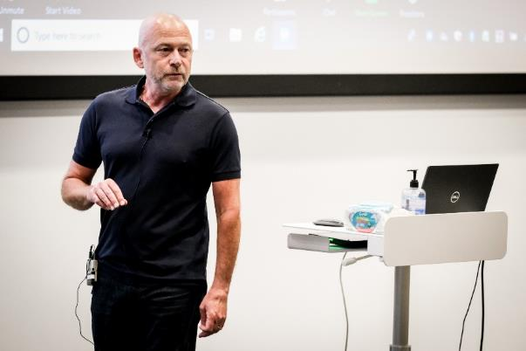

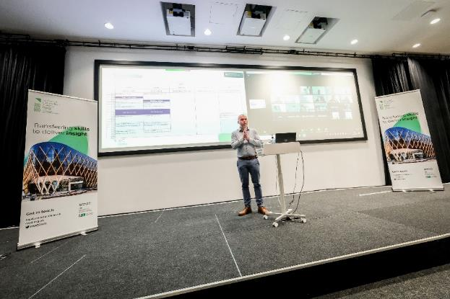

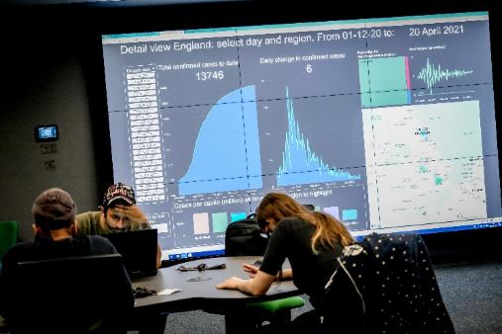
Data Innovation Bootcamps
Understanding
Understanding
Scoping the
Solution Design
Solution Pitch
the Problem
the Data
Solution
& Build
and Feedback
Notes:
And we run the event out of our building – the Catalyst and it’s a real immersive event for the students with business co-located with them

Slide 17

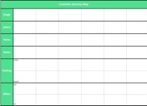

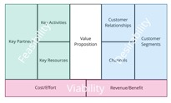

Building towards a solution
Communication
MVP
Business Model
Value
Data
Communication is key to achieving buy-in for ideas. Using the MVP, methods of communication are explored and fed back to the problem owner.
Customer
Problem
Our collective understanding of the customer, the value we can create and the business model allows us to design an effective first step – the Minimum Viable Product
Understanding the business model, its connections, relationships and dependencies allows us to understand the big picture
A solid value proposition addresses customer needs and achieves product-market fit
Fundamental data analysis techniques. First steps into exploring and communicating data.
Exploring the customer jobs, pains and gains leads to understanding the real business need
Deep dive into the problem before considering solutions
Day 1
Day 2
Days 3 & 4
Days 5 & 6
Day 7
Day 8
Days 9 & 10
Customer Journey Map
Value Proposition Template
Business Model Canvas
Project delivery plan

Slide 18

“If I had an hour to solve a problem I'd spend 55 minutes thinking about the problem and five minutes thinking about solutions.”

Slide 19
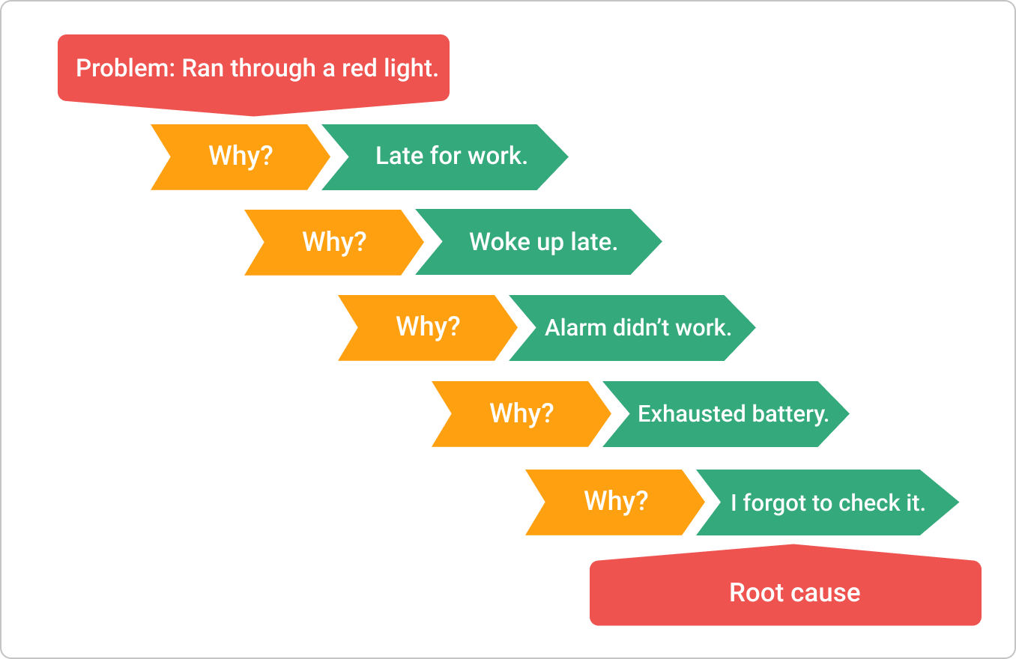

Root Cause Analysis - 5 Whys
Questions:
Why didn’t we send the newsletter on time? Updates were not implemented until the deadline.
Why were the updates not implemented on time? Because the developers were still working on the new features.
Why were the developers still working on the new features? One of the new developers didn’t know the procedures.
Why was the new developer unfamiliar with all procedures? He was not trained properly.
Why was he not trained properly? Because CTO believes that new employees don’t need thorough training and they should learn while working.
You can notice that the root cause of the initial problem turned out to be something completely different from most expectations.

Slide 20
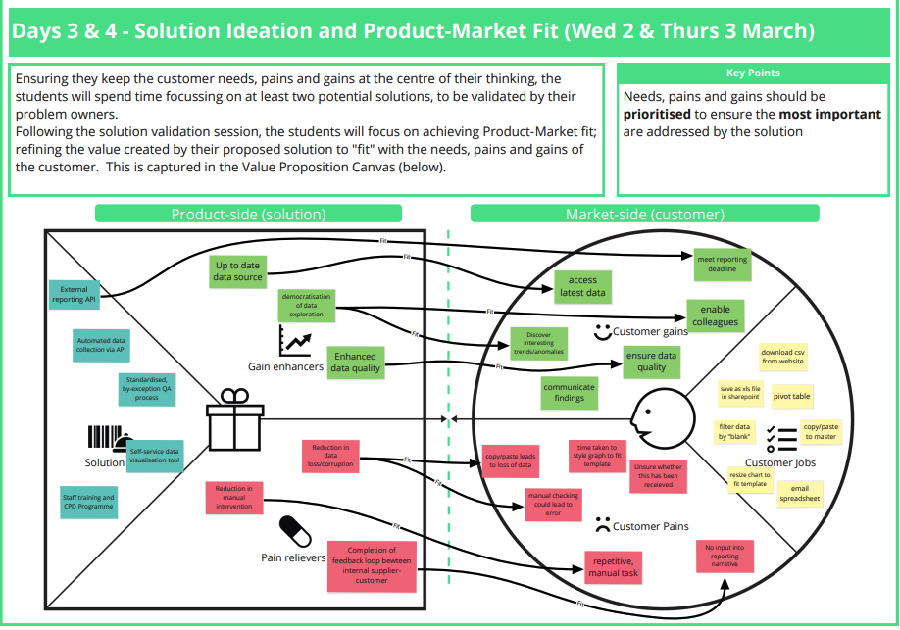

Slide 21
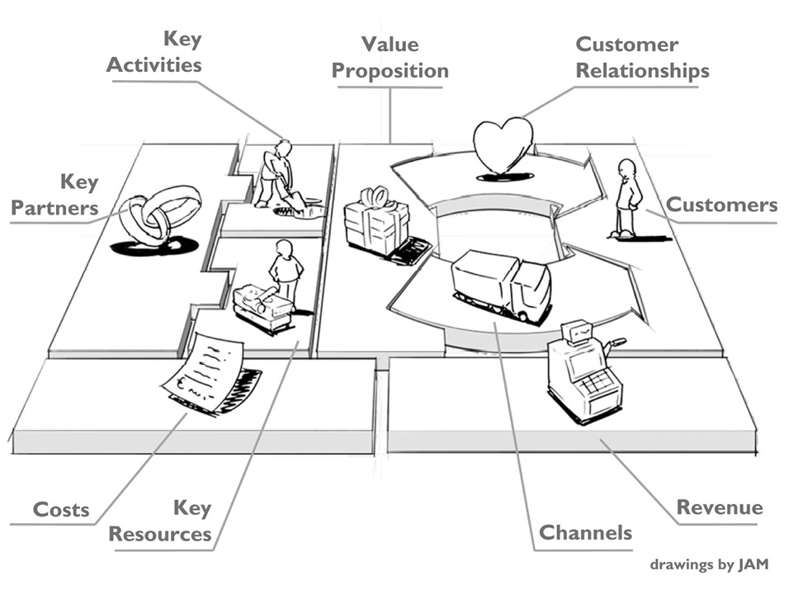
Business Model Canvas

Slide 22
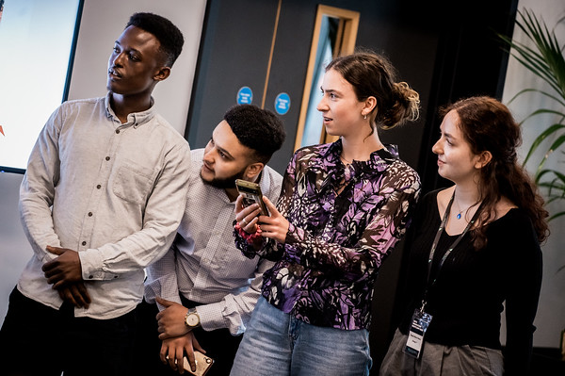
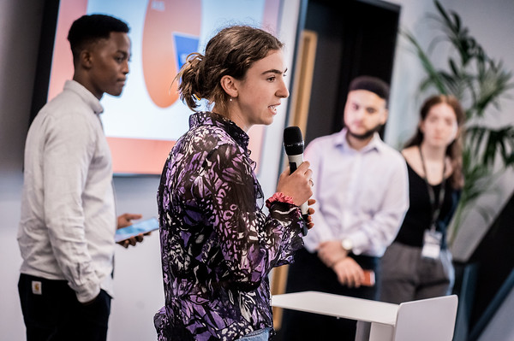

Slide 23

Process
Explore
Understand
Design
Communicate
Step 1
Problem
Customer
Evaluate
Problem
Root Cause(s)
MVP
Step 2
Context
Iterate
Customer
Needs
Evaluate
Step 3
Business Model
Value Proposition

Slide 24
Benefits
For Students
Teamwork and collaboration, critical thinking, problem solving and decision-making – these skills top lists of most desirable skills for employees across all industry sectors.
Practical experience handling real-world data makes students aware of how ‘messy’ they can be – practical skills attractive to employers
Networking during the programme with student peers and the industrial participants - can lead to future internships, mentorships and job offers.
For Business
300 hours of businesses insight from two groups of 5 students over 5 days.
Students bring fresh perspectives and new ideas
Chance to work with and spot talented students that could lead to future recruitment.
Proposed new business models can uncover potential new revenue streams and efficiencies within the current business operations.
For University
New pathway for relationships with industry.
Working together creates stronger ties and partnerships and potentially lead to future research collaborations, internships, and joint ventures.
Skills acquired by students contribute to student employability and could be used by universities to demonstrate tangible graduate outcomes.
Attractive to international students.

Slide 25
That’s the end – thank you
3. Call-to-action
I think we should all be doing more activities like this and I’d like to talk to all of you about similar activities that you may already do and maybe there’s some way we can collaborate?

